Slide 1

Algorithms
01
02
Algorithm Complexity
Sorting Algorithms
03

Slide 2
Content
01
Complexity
02
Simple Sorting
03
Advanced Sorting

Slide 3

Alen Paunov
Alen has 12 years of experience as a teacher and lecturer in various fields and educational organizations. After 6 years of working in the legal services sector, he decides to dedicate himself to software technologies.
He has been an Educational Director in multiple academies and organizations. Throughout this time, he has successfully balanced the responsibilities of his position with his great passion for teaching.

Slide 4
01
Algorithm Complexity
What is an Algorithm

Slide 5
What is an Algorithm
Set of step-by-step instructions to solve specific problem.
What is sorting algorithm
An algorithm that rearranges elements
Elements must be comparable
More formally
The input is a sequence of elements
The output is a rearrangement permutation of elements

Slide 6
Time Complexity
Going to work:
By foot
Bicycle
Car
Teleportation
 | Work
By foot | 40 min
Bicycle | 20 min
Car | 10 min
Teleportation | 60 min

Slide 7
Time Complexity
 | Work | Varna
By foot | 40 min | 5000 min
Bicycle | 20 min | 1000 min
Car | 10 min | 300 min
Teleportation | 60 min | 60 min

Slide 8
Algorithm Analysis
Why should we analyze algorithms?
Predict the resources the algorithm will need
Computational time (CPU consumption)
Memory space (RAM consumption)
Communication bandwidth consumption
Hard disk operations

Slide 9
Algorithm Analysis
The expected running time of an algorithm is:
The total number of primitive operations executed (machine independent steps)
Also known as algorithm complexity
Compare algorithms ignoring details such as language or hardware

Slide 10
Algorithmic Complexity
What to measure?
CPU time
Memory consumption
Number of steps
Number of particular operations
Number of disk operations
Number of network packets
Asymptotic complexity

Slide 11
Complexities for input of size N
Number of operations | Big O | Short name
1, 5, 10, 10 000 | O( 1 ) | constant
logN, logN + 10 | O( logN ) | logarithmic
N, 2N, 10N + 5 | O( N ) | linear
N log N, N log 2N | O( N log N ) | linearithmic
N^2, 3N^2 + N + 1 | O( N^2 ) | quadratic
N^3, N^3 + N^2 | O( N^3 ) | cubic
N^K, K - constant | O( N^K ) | polynomial
2^N, 3^N, 2^N + N^2 | O( 2^N ) | exponential
N! | O( N! ) | factorial

Slide 12
SumEven Number of Steps
Calculate maximum steps to find sum of even elements in an array
Assume that a single step is a single CPU instruction:
assignments, array lookups, comparisons, arithmetic operations
T(n)= 7n + 4.
int SumEven(int[] array)
{
int sum = 0;
for (int i = 0; i < array.Length; i++)
if (array[i] % 2 == 0) sum += array[i];
return sum;
}

Slide 13
Steps
int sum = 0; - 1 operation.
for (int i = 0; i < array.Length; i++) The loop will run n times (where n is the length of the array).
Inside the loop:
i < array.Length - Comparison operation. It happens n + 1 times (one extra for when the loop terminates).
i++ - Increment operation. It happens n times.
array[i] % 2 == 0 - This involves accessing the array and checking if a number is even. This happens n times.
sum += array[i] - For the worst-case complexity, we assume it happens every time.
return sum; - 1 operation.

Slide 14
Steps
Initialization: 1 (for sum) Initialization: 1 (for i)
Loop comparison: n + 1
Loop increment: n
Check even: n
Addition: n
Total operations = 7n + 4
n = 2 -> 18;
n = 4 -> 32;
n = 10 -> 74;

Slide 15
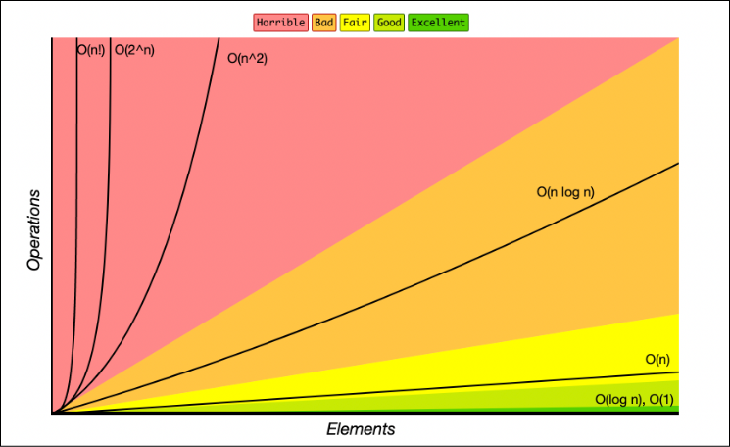
Time Complexity
Worst-case
An upper bound on the running time
Average-case
Average running time
Best-case
The lower bound on the running time (the optimal case)

Slide 16
Algorithm Complexity
Algorithm complexity – rough estimation of the number of steps performed by given computation, depending on the size of the input
Measured with asymptotic notation
O(f(n)) – read "Big oh of f(n)"
Θ(f(n)) – read "Theta of f(n)"
Ω(f(n)) – read "Omega of f(n)"
where f(n) is a function of the size of the input data

Slide 17
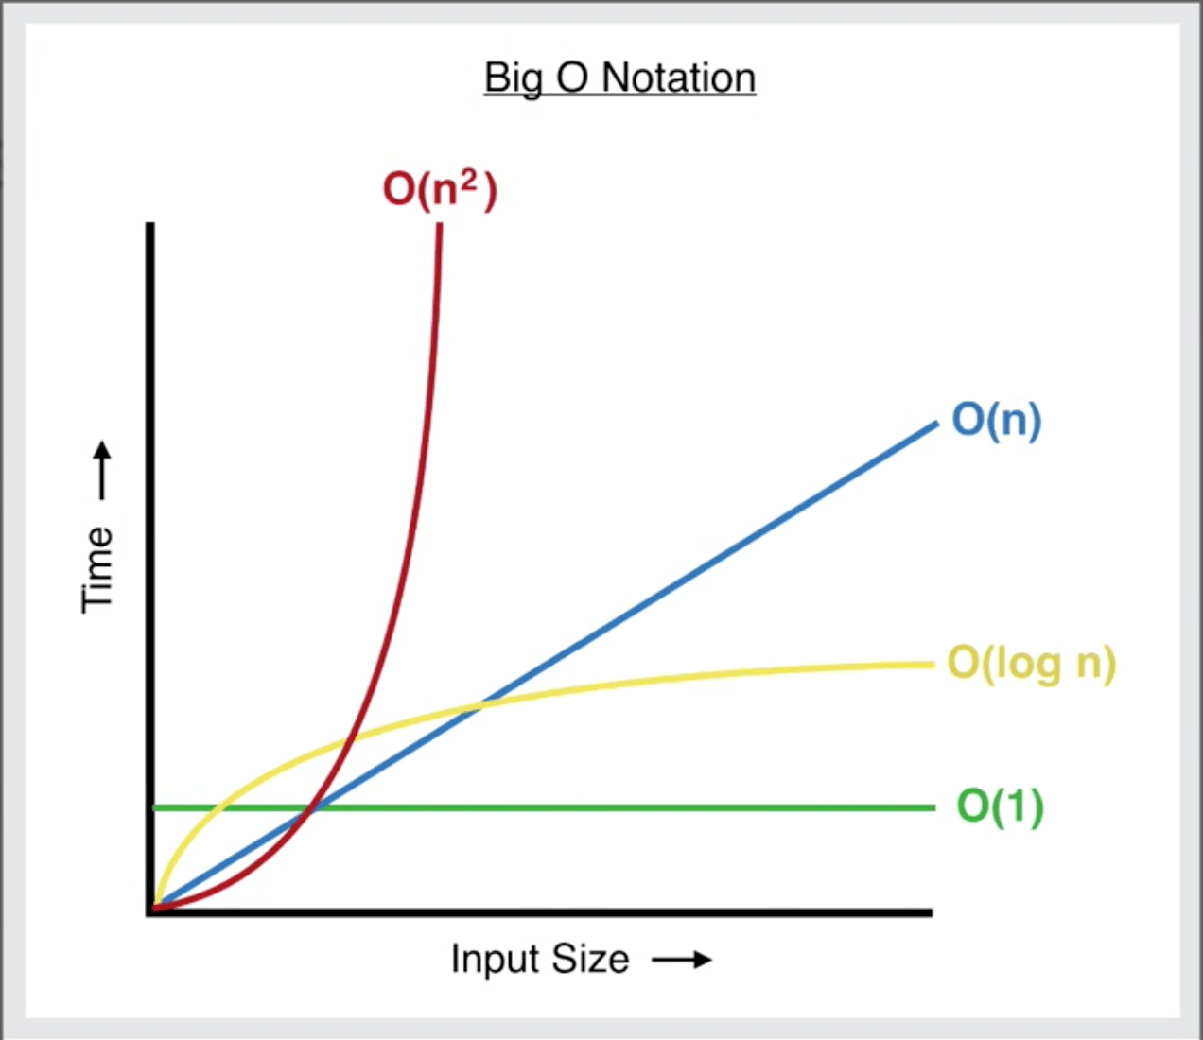
Asymptotic Notations
O(f(n)) – Upper bound
Ω(f(n)) – Lower bound
Θ(f(n)) – Upper & Lower bound
Big O: "It won't be worse than this."
Big Omega: "It won't be better than this."
Big Theta: "It will be this way."

Slide 18
Functions Growth Rate
О(n) means a function grows linearly when n increases
E.g.
O(n2) means a function grows exponentially when n increases
E.g.
O(1) means a function does not grow when n changes
E.g.
ƒ(n) = n+1
ƒ(n)
18
17
16
15
14
13
12
11
10
9
8
7
6
5
4
3
2
1
0
ƒ(n) = n²+2n+2
ƒ(n)=4
0 1 2 3 4 5 6 7 8 9 10 11 12 13 14 15
n

Slide 19
Typical Complexities
Complexity | Notation | Description
constant | O(1) | n = 1 000 → 1-2 operations
logarithmic | O(log n) | n = 1 000 → 10 operations
linear | O(n) | n = 1 000 → 1 000 operations
linearithmic | O(n*log n) | n = 1 000 → 10 000 operations
quadratic | O(n²) | n = 1 000 → 1 000 000 operations
cubic | O(n³) | n = 1 000 → 1 000 000 000 operations
exponential | O(n^{n}) | n = 10 → 10 000 000 000 operations

Slide 20
Terminology
O(1): Constant Time - The algorithm takes a constant amount of time, regardless of the input size. This is the ideal scenario.
O(log n): Logarithmic Time - The algorithm's time requirement grows logarithmically with the input size. Binary search is an example.
O(n): Linear Time - The running time grows linearly with the input size. For example, a simple search through an array.
O(n * log n): Linearithmic Time - This is commonly seen in efficient sorting algorithms like mergesort and heapsort.
O(n^2), O(n^3), ... : Polynomial Time - These are often seen in nested loops. For instance, bubble sort has a worst-case and average-case time complexity of O(n^2).
O(2^n): Exponential Time - Algorithms with this complexity are often impractical for large inputs. Recursive algorithms that solve a problem of size n by recursively solving two smaller problems of size n-1 exhibit this complexity.

Slide 21

Constant Time - O(1)
Imagine you always keep your favorite toy on top. No matter how many toys are in the box, you can just open it and grab your favorite toy immediately.

Slide 22






Linear Time - O(n)
This time, your toy could be anywhere in the box. You start by looking at the first toy, then the second, then the third, and so on until you find it.
If you have 10 toys, it might take you 10 tries to find your favorite. If you have 100 toys, in the worst case, it might take 100 tries.

Slide 23
Quadratic Time - O(n^2)
Imagine you have a bunch of toy boxes inside your big toy box, and you must search each small toy box one by one.
For every toy box you open, you also must look through all the toys inside. If there are 10 boxes, and each has 10 toys, you might have to look 100 times in total! That's a lot more work!

Slide 24
Logarithmic Time - O(log n)
Imagine you're playing a guessing game where you must find a number between 1 and 100, and every time you guess, a friend tells you if your number is too high, too low, or just right.
Even if there are 100 numbers to choose from, you can find the right number in just 7 guesses or less because you can keep cutting the number of choices in half.

Slide 25
02
Simple Sorting
Bubble, Insertion, Selection Sort

Slide 26

Sorting – Example
Efficient sorting is important for:
Producing human-readable output
Canonicalizing data – making data uniquely arranged
In conjunction with other algorithms, like binary searching
Example of sorting:
10 | 3 | 7 | 3 | 4
3 | 3 | 4 | 7 | 10
Unsorted list
Sorted list

Slide 27
Classification
Sorting algorithms are often classified by
Computational complexity and memory usage
Worst, average and best-case behavior
Recursive / non-recursive
Stability – stable / unstable
Comparison-based sort / non-comparison based
Sorting method: insertion, exchange (bubble sort and quicksort), selection (heapsort), merging, serial / parallel, etc.

Slide 28
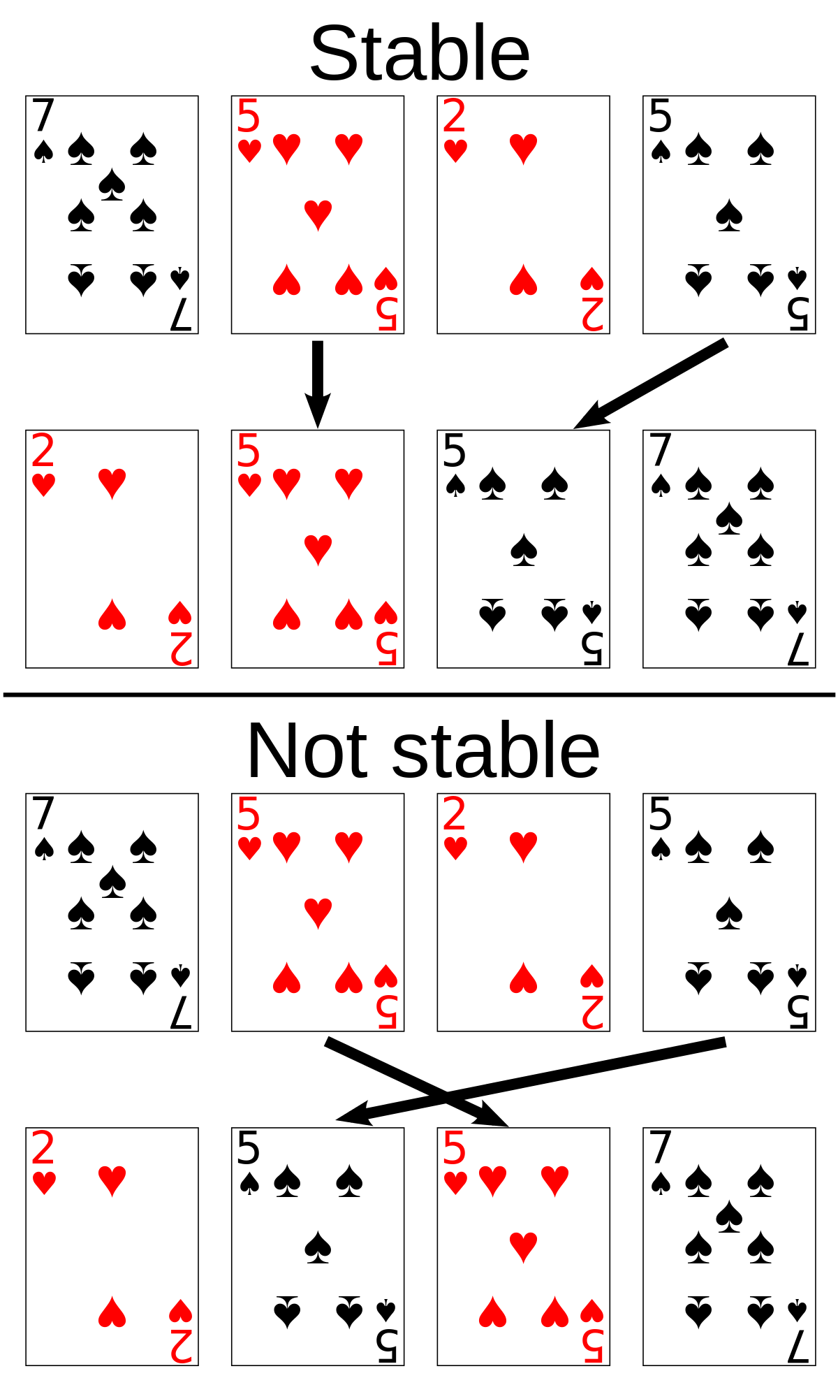
Stability
Stable sorting algorithms
Maintain the order of equal elements
If two items compare as equal, their relative order is preserved
Unstable sorting algorithms
Rearrange the equal elements in unpredictable order
Often different elements have same key used for equality comparing

Slide 29
Bubble Sort
Bubble sort – simple, but inefficient algorithm
Swaps to neighbor elements when not in order until sorted
Memory: O(1)
Stable: Yes
Method: Exchanging
Usage:
Useful for educational purposes due to its simplicity.
Not typically used in real-world applications due to its inefficiency.
Slower compared to most of the sorting algorithms for larger lists.

Slide 30
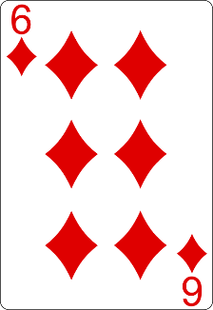
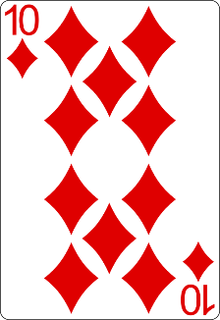
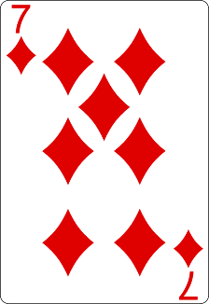
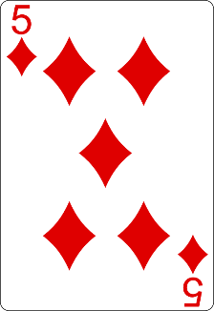
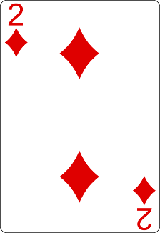
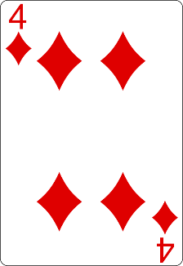
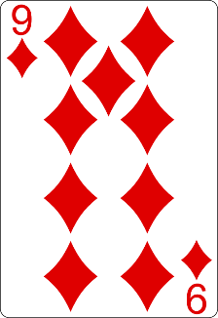
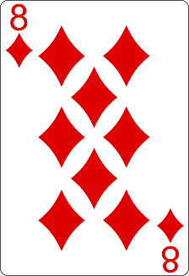
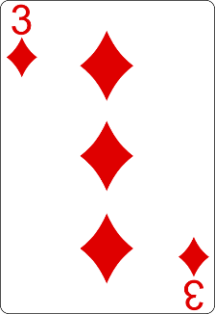
Bubble Sort
i
j

Slide 31
Bubble Sort
i
j

Slide 32
Bubble Sort
i
j

Slide 33
Bubble Sort
i
j

Slide 34
Bubble Sort
i
j

Slide 35
Bubble Sort
i
j

Slide 36
Bubble Sort
i
j

Slide 37
Bubble Sort
i
j

Slide 38
Bubble Sort
i
j

Slide 39
Bubble Sort
i
j

Slide 40
Bubble Sort
i
j

Slide 41
Bubble Sort
i
j

Slide 42
Bubble Sort
i
j

Slide 43
Bubble Sort
i
j

Slide 44
Bubble Sort
i
j

Slide 45
Bubble Sort
i
j

Slide 46
Bubble Sort
i
j

Slide 47
Bubble Sort
i
j

Slide 48
Bubble Sort
i
j

Slide 49
Bubble Sort
i
j

Slide 50
Bubble Sort
i
j

Slide 51
Bubble Sort
i
j

Slide 52
Bubble Sort
i
j

Slide 53
Bubble Sort
i
j

Slide 54
Bubble Sort
i
j

Slide 55
Bubble Sort
i
j

Slide 56
Bubble Sort
i
j

Slide 57
Bubble Sort
i
j

Slide 58
Bubble Sort
i
j

Slide 59
Bubble Sort
i
j

Slide 60
Bubble Sort
i
j

Slide 61
Bubble Sort
i
j

Slide 62
Bubble Sort
i
j

Slide 63
Bubble Sort
i
j

Slide 64
Bubble Sort
i
j

Slide 65
Bubble Sort
i
j

Slide 66
Bubble Sort
i
j

Slide 67
Bubble Sort

Slide 68
Selection Sort
Selection sort – simple, but inefficient algorithm
Swap the first with the min element on the right, then the second, etc.
Memory: O(1)
Stable: No
Method: Selection
Usage:
Like Bubble Sort, mostly useful for educational purposes.
Not efficient for large lists.
It always performs the same number of comparisons, so its performance doesn't vary between best, average, and worst cases.

Slide 69
Selection Sort
Index

Slide 70
Selection Sort
Index
Min

Slide 71
Selection Sort
Index
Min

Slide 72
Selection Sort
Index
Min

Slide 73
Selection Sort
Index
Min

Slide 74
Selection Sort
Index
Min

Slide 75
Selection Sort
Index
Min

Slide 76
Selection Sort
Index
Min

Slide 77
Selection Sort
Index
Min

Slide 78
Selection Sort
Index
Min

Slide 79
Selection Sort
Index
Min

Slide 80
Selection Sort
Min
Index

Slide 81
Selection Sort
Min
Index

Slide 82
Selection Sort
Min
Index

Slide 83
Selection Sort
Index
Min

Slide 84
Selection Sort
Min
Index

Slide 85
Selection Sort
Min
Index

Slide 86
Selection Sort

Slide 87
Selection Sort

Slide 88
Why Unstable?
Why the "selection sort" is unstable?
Swaps the first element with the min element on the right
Swaps the second element with the min element on the right
…
During the swaps equal elements can jump over each other
left
min
swap
equal elements
changed order
3♥ | 5♠ | 3♦ | 4♥ | 2♣
3♥ | 5♠ | 3♦ | 4♥ | 2♣
2♣ | 5♠ | 3♦ | 4♥ | 3♥

Slide 89
Insertion Sort
Insertion sort – simple, but inefficient algorithm
Move the first unsorted element left to its place
Memory: O(1)
Stable: Yes
Method: Insertion
Usage:
Highly efficient for small datasets or nearly sorted datasets.
Simple implementation.
More efficient in practice than other O(n^2) algorithms like Bubble Sort for small lists.

Slide 90
Insertion Sort

Slide 91
Insertion Sort

Slide 92
Insertion Sort

Slide 93
Insertion Sort

Slide 94
Insertion Sort

Slide 95
Insertion Sort

Slide 96
Insertion Sort

Slide 97
Insertion Sort

Slide 98
Insertion Sort

Slide 99
Insertion Sort

Slide 100
Insertion Sort

Slide 101
Insertion Sort

Slide 102
Insertion Sort

Slide 103
Insertion Sort

Slide 104
Insertion Sort

Slide 105
Insertion Sort

Slide 106
Insertion Sort

Slide 107
Insertion Sort

Slide 108
Insertion Sort

Slide 109
Insertion Sort

Slide 110
Insertion Sort

Slide 111
Insertion Sort

Slide 112
Insertion Sort

Slide 113
Insertion Sort

Slide 114
Insertion Sort

Slide 115
Insertion Sort

Slide 116
Insertion Sort

Slide 117
Insertion Sort

Slide 118
Insertion Sort

Slide 119
Insertion Sort

Slide 120
Insertion Sort

Slide 121
Insertion Sort

Slide 122
Insertion Sort

Slide 123
Insertion Sort

Slide 124
Comparison
Name | Best | Average | Worst | Memory | Stable | Method
SelectionSort | n² | n² | n² | 1 | No | Selection
BubbleSort | n | n² | n² | 1 | Yes | Exchanging
InsertionSort | n | n² | n² | 1 | Yes | Insertion

Slide 125
03
Advanced Sorting
Quick, Merge, Bucket Sort

Slide 126
Quick Sort
QuickSort – efficient sorting algorithm
Choose a pivot; move smaller elements left & larger right; sort left & right
Best & average case: O(n*log(n)); Worst: O(n2)
Memory: O(log(n))
Stable: Depends
Method: Partitioning
Usage:
Highly efficient for large datasets.
Often faster in practice than other O(n log n) algorithms like Merge Sort or Heap Sort.
Worst-case performance can be avoided by using randomized pivot selection.

Slide 127
Quick Sort

Slide 128
Quick Sort

Slide 129
Quick Sort

Slide 130
Quick Sort

Slide 131
Quick Sort

Slide 132
Quick Sort

Slide 133
Quick Sort

Slide 134
Quick Sort

Slide 135
Quick Sort

Slide 136
Quick Sort

Slide 137
Quick Sort

Slide 138
Quick Sort

Slide 139
Quick Sort

Slide 140
Quick Sort

Slide 141
Quick Sort

Slide 142
Quick Sort

Slide 143
Quick Sort

Slide 144
Quick Sort

Slide 145
Quick Sort

Slide 146
Quick Sort

Slide 147
Quick Sort

Slide 148
Quick Sort

Slide 149
Quick Sort

Slide 150
Quick Sort

Slide 151
Quick Sort

Slide 152
Quick Sort

Slide 153
Quick Sort

Slide 154
Quick Sort

Slide 155
Quick Sort

Slide 156
Quick Sort

Slide 157
Quick Sort

Slide 158
Quick Sort

Slide 159
Quick Sort

Slide 160
Quick Sort

Slide 161
Quick Sort

Slide 162
Quick Sort

Slide 163
Quick Sort

Slide 164
Merge Sort
Merge sort is efficient sorting algorithm
Divide the list into sub-lists (typically 2 sub-lists)
Sort each sub-list (recursively call merge-sort)
Merge the sorted sub-lists into a single list
Best, average and worst case: O(n*log(n))
Memory:
Typically, O(n)
With in-place merge can be O(1)
Usage:
Provides stable sort and consistent O(n log n) performance.
Good choice when data stability is a concern.
Uses more space compared to in-place algorithms like Quick Sort.

Slide 165
Merge Sort

Slide 166
Merge Sort

Slide 167
Merge Sort

Slide 168
Merge Sort

Slide 169
Merge Sort

Slide 170
Merge Sort

Slide 171
Counting Sort
Counting sort is a very efficient sorting algorithm
Sorts small integers by counting their occurrences
Not a comparison-based sort
Best, average and worst case: O(n + k)
k is the range of numbers to be sorted
E.g. [-1000 ... 1000] → k = 2001
Memory: O(n + k) Space: O(k)
Stable: Yes
Method: Counting

Slide 172
Counting Sort
1 | 2 | 3 | 4 | 5
0 | 0 | 0 | 0 | 0

Slide 173
Counting Sort
1 | 2 | 3 | 4 | 5
0 | 1 | 0 | 0 | 0

Slide 174
Counting Sort
1 | 2 | 3 | 4 | 5
0 | 1 | 1 | 0 | 0

Slide 175
Counting Sort
1 | 2 | 3 | 4 | 5
0 | 1 | 1 | 1 | 0

Slide 176
Counting Sort
1 | 2 | 3 | 4 | 5
0 | 1 | 1 | 1 | 1

Slide 177
Counting Sort
1 | 2 | 3 | 4 | 5
0 | 1 | 1 | 2 | 1

Slide 178
Counting Sort
1 | 2 | 3 | 4 | 5
0 | 1 | 2 | 2 | 1

Slide 179
Counting Sort
1 | 2 | 3 | 4 | 5
0 | 1 | 3 | 2 | 1

Slide 180
Counting Sort
1 | 2 | 3 | 4 | 5
0 | 2 | 3 | 2 | 1

Slide 181
Counting Sort
1 | 2 | 3 | 4 | 5
0 | 2 | 4 | 2 | 1

Slide 182
Counting Sort
1 | 2 | 3 | 4 | 5
0 | 1 | 4 | 2 | 1

Slide 183
Counting Sort
1 | 2 | 3 | 4 | 5
0 | 0 | 4 | 2 | 1

Slide 184
Counting Sort
1 | 2 | 3 | 4 | 5
0 | 0 | 3 | 2 | 1

Slide 185
Counting Sort
1 | 2 | 3 | 4 | 5
0 | 0 | 2 | 2 | 1

Slide 186
Counting Sort
1 | 2 | 3 | 4 | 5
0 | 0 | 1 | 2 | 1

Slide 187
Counting Sort
1 | 2 | 3 | 4 | 5
0 | 0 | 0 | 2 | 1

Slide 188
Counting Sort
1 | 2 | 3 | 4 | 5
0 | 0 | 0 | 1 | 1

Slide 189
Counting Sort
1 | 2 | 3 | 4 | 5
0 | 0 | 0 | 0 | 1

Slide 190
Counting Sort
1 | 2 | 3 | 4 | 5
0 | 0 | 0 | 0 | 0

Slide 191
Comparison
Name | Best | Average | Worst | Memory | Stable | Method
SelectionSort | n² | n² | n² | 1 | No | Selection
BubbleSort | n | n² | n² | 1 | Yes | Exchanging
InsertionSort | n | n² | n² | 1 | Yes | Insertion
QuickSort | n*log(n) | n*log(n) | n² | log(n) | No? | Partitioning
MergeSort | n*log(n) | n*log(n) | n*log(n) | 1 (or n) | Yes | Merging
HeapSort | n*log(n) | n*log(n) | n*log(n) | 1 | No | Selection
BogoSort | n | n*n! | n*n! | 1 | No | Luck

